Slide 1
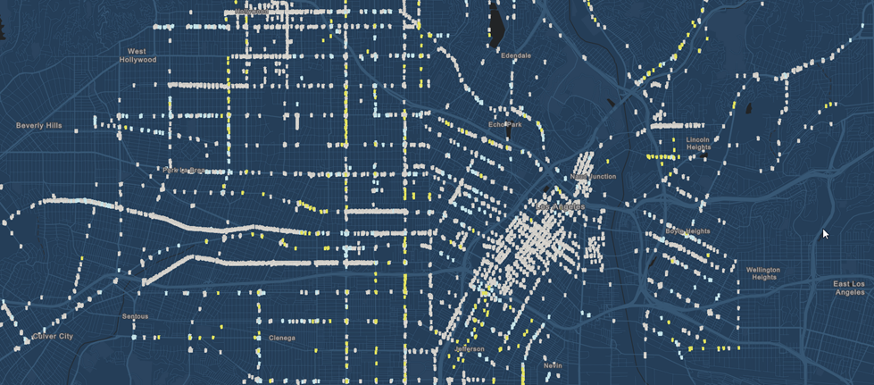
Analysis of Violent Crime Trends in Los Angeles, CA (2010 – 2017)
Los Angeles, CA
Jon Heston, Eleanora Trittipo, Shrawantee Saha

Slide 2
Project Requirements
The technical requirements for Project 1 are as follows.
Use Pandas to clean and format your data set(s)
Create a Jupyter Notebook describing the data exploration and cleanup process
Create a Jupyter Notebook illustrating the final data analysis
Use Matplotlib to create a total of 6-8 visualizations of your data (ideally, at least 2 per "question" you ask of your data)
Save PNG images of your visualizations to distribute to the class and instructional team, and for inclusion in your presentation
Optionally, use at least one API, if you can find an API with data pertinent to your primary research questions
Create a write-up summarizing your major findings. This should include a heading for each "question" you asked of your data, and under each heading, a short description of what you found and any relevant plots.

Slide 3
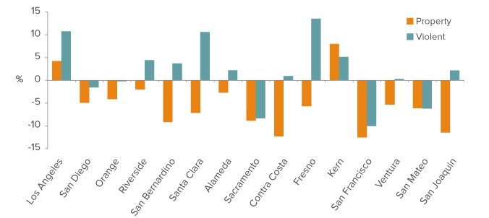
Motivation
Crime Trends in California(2016)*:
California’s violent crime rate rose in 2016—but it remains historically low.
The statewide property crime rate decreased in 2016.
Crime rates vary dramatically by region and category.
Violent crime increased in a majority of counties …
… but property crime decreased in most counties.
*Public Policy Institute of California publication in November 2017: http://www.ppic.org/publication/crime-trends-in-california/

Slide 4
Questions
Focus on incidence of crime in Los Angeles city:
Trends in violent crime rates
2010 to 2017.
More specifically:

Slide 5
Rest of the presentation
Data Sources
Data Cleaning & Technical Applications
Data Description
Results
Conclusions
Future Work/Assignments

Slide 6
Data Sources
Incidence of Crime Data: Los Angeles Open Data
Demographic and Socio-Economic Data: Los Angeles Census Reporter
Mapping Library: Folium 0.6.0
Boundary Files for Mapping: L.A. Boundaries API

Slide 7
Rest of the presentation
Data Cleaning & Technical Applications
Data Description
Results
Conclusions
Future Work/Assignments

Slide 8
Data Cleaning & Technical Applications

Slide 9
Rest of the presentation
Data Description
Results
Conclusions
Future Work/Assignments

Slide 10
Data description
Number of observations (raw dataset) : 1,800,985
Number of observations (after cleanup) : ????
Years (raw dataset) : 2010 to 2018 (August)
Years (included in our analysis): 2010 to 2017

Slide 11
Data Description: Classification of crime
US Department of Justice classifies crime in two major groups:
Violent Crime
Property Crime
Violent crime includes
Homicide
Rape
Robbery
Assault
Purse snatching and pocket picking
*For more information: https://www.bjs.gov/index.cfm?ty=tp&tid=93 (as viewed on 18th August 2018)

Slide 12
Data Description: Violent Crime in LA City
Need to clean this one!!!
"BATTERY - SIMPLE ASSAULT", "ASSAULT WITH DEADLY WEAPON, AGGRAVATED ASSAULT", "ROBBERY", "THEFT PERSON","INTIMATE PARTNER - AGGRAVATED ASSAULT", "BURGLARY, ATTEMPTED", "BATTERY WITH SEXUAL CONTACT", "RAPE, FORCIBLE", "CHILD ABUSE (PHYSICAL) - SIMPLE ASSAULT", "CRM AGNST CHLD (13 OR UNTER) (14-15 & SUSP 10 YRS OLDER)0060", "CHILD NEGLECT (SEE 300 W.I.C.)", "BATTERY POLICE (SIMPLE)", "SEX, UNLAWFUL", "DISCHARGE FIREARMS/SHOTS FIRED", "ARSON","OTHER ASSAULT", "CRIMINAL HOMICIDE", "SHOTS FIRED AT INHABITED DWELLING", "EXTORTION", "KIDNAPPING", "ORAL COPULATION", "SEXUAL PENETRATION WITH A FOREIGN OBJECT", "CHILD ABUSE (PHYSICAL) - AGGRAVATED ASSAULT", "ASSAULT WITH DEADLY WEAPON ON POLICE OFFICER", "THROWING OBJECT AT MOVING VEHICLE", "LEWD CONDUCT", "SODOMY/SECUAL CONTACT B/W PENIS OF ONE PERS TO ANUS OTH 0007=02", "CHILD STEALING", "RAPE, ATTEMPTED", "FALSE IMPRISONMENT", "KIDNAPPING - GRAND ATTEMPT", "SEXUAL PENETRATION W/FOREIGN OBJECT", "PIMPING", "CRIM AGNST CHLD (13 OR UNDER) (14-15 & SUSP 10 YRS OLDER)", "SEX,UNLAWFUL(INC MUTUAL CONSENT, PENETRATION W/ FRGN OBJ0059", "BATTERY ON A FIREFIGHTER", "THEFT FROM PERSON - ATTEMPT", "SHOTS FIRED AT MOVING VEHICLE, TRAIN OR AIRCRAFT", "SEX,UNLAWFUL(INC MUTUAL CONSENT, PENETRATION W/ FRGN OBJ", "HUMAN TRAFFICKING - COMMERCIAL SEX ACTS", "SODOMY/SEXUAL CONTACT B/W PENIS OF ONE PERS TO ANUS OTH", "LEWD/LASCIVIOUS ACTS WITH CHILD", "CHILD PORNOGRAPHY", "LYNCHING", "DRUGS, TO A MINOR", "HUMAN TRAFFICKING - INVOLUNTARY SERVITUDE", "LYNCHING - ATTEMPTED", "INCITING A RIOT", "INCEST (SEXUAL ACTS BETWEEN BLOOD RELATIVES)", "ABORTION/ILLEGAL", "MANSLAUGHTER, NEGLIGENT", "TRAIN WRECKING"]

Slide 13
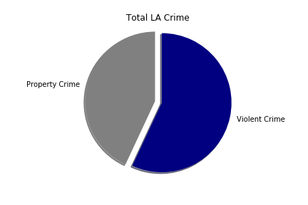
Trends from our data
Need a legend here as well:
For the year? I Am assuming this is for all the years in our dataset for the years 2010 to 2017

Slide 14
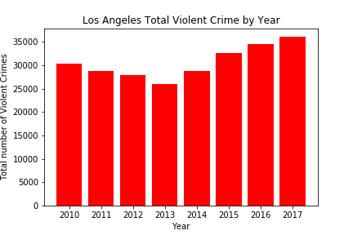
Trends from our data

Slide 15
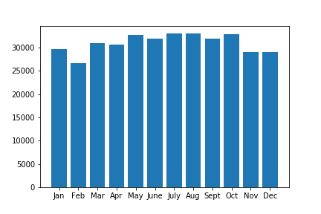
Trends from our data

Slide 16
Rest of the presentation
Results
Conclusions
Future Work/Assignments

Slide 17
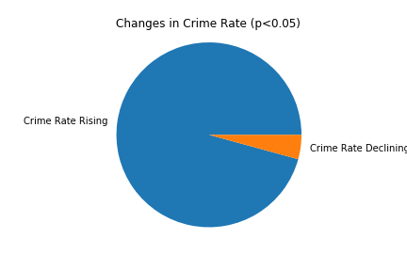
Results
Need a legend for this pie chart

Slide 18
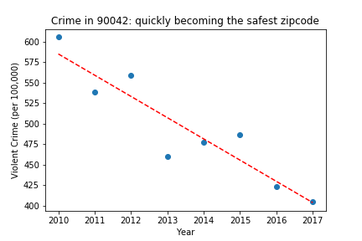
Results

Slide 19
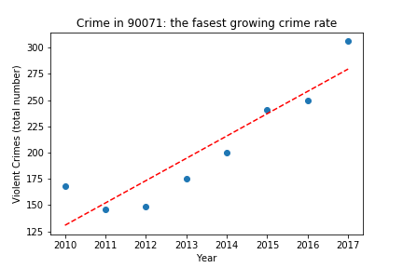
Results

Slide 20
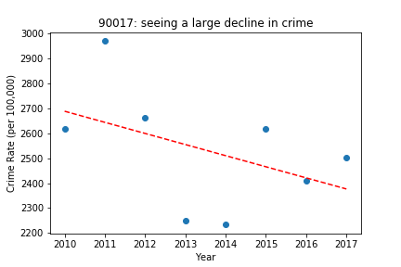
Results

Slide 21
Conclusions
1.
2.
3.

Slide 22
Future Work/Assignments
1. … but property crime decreased in most counties.
2.
3.

Slide 23
References
1. https://blog.dominodatalab.com/creating-interactive-crime-maps-with-folium/
Thanks to Jake and Chris!

